Slide 1
Network and Transport Layer

Slide 2
Unit-4: Network and Transport Layer:
Host to Host Delivery: Internetworking, Addressing and Routing, Network Layer Protocols: ARP, IPV4, ICMP, IPV6
Transport Layer: Process to Process Delivery: UDP, TCP, Congestion Control. Routing Protocols: AODV, DSDV, DSR.

Slide 3
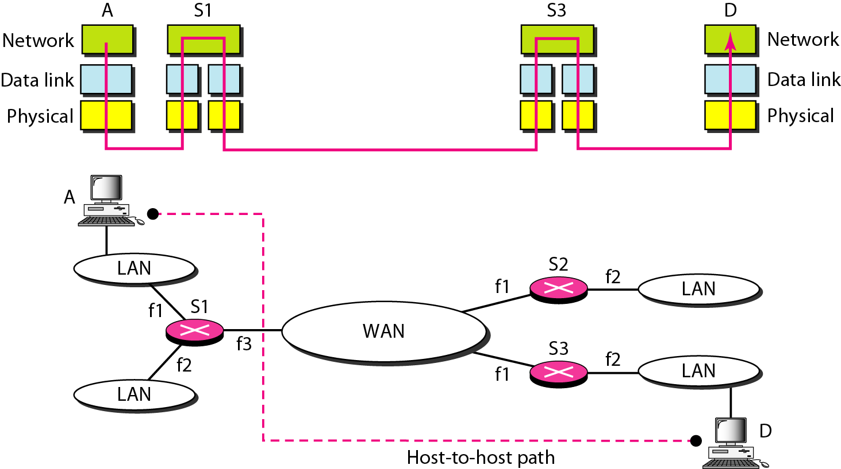
Internetworking
The communication at the network layer is host-to-host.
Internetworking is the process of connecting different networks by using intermediary devices such as routers or gateway devices.
The interconnected networks are called an internetwork, or simply an internet.
Internetworking is only possible when all the connected networks use the same protocol stack or communication methodologies.

Slide 4
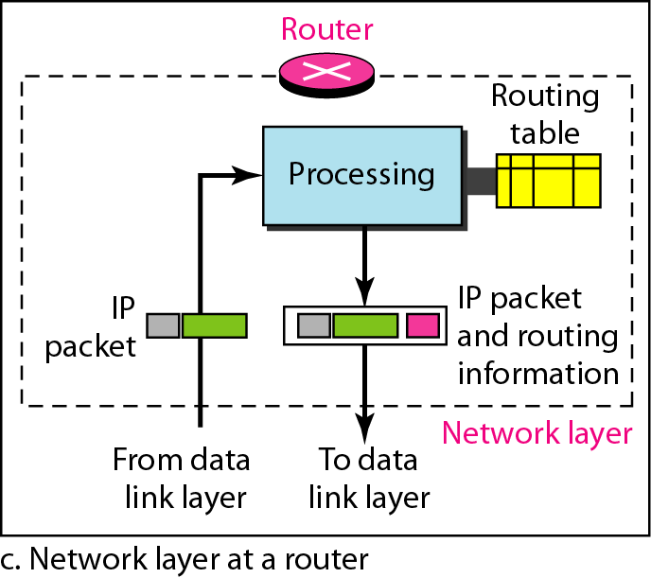
Router
Router:
❖ A router is a three-layer device; physical, data link and network layer.
❖ As a physical layer device it can regenerates bit, as data link layer device the router can check the physical addresses contained in a packet and as a network layer device it can check the network layer addresses (addresses in IP layer).
Routing:
❖ Routing refers to the process of selecting the shortest and the most reliable path over which to send data to its ultimate destination.
❖ IP routing protocol makes the distinction between hosts and gateways.
❖ A host is the end system to which data is ultimately deliverable.
❖ An IP gateway, on the other hand, is the router that accomplishes the act of routing data between two networks.

Slide 5
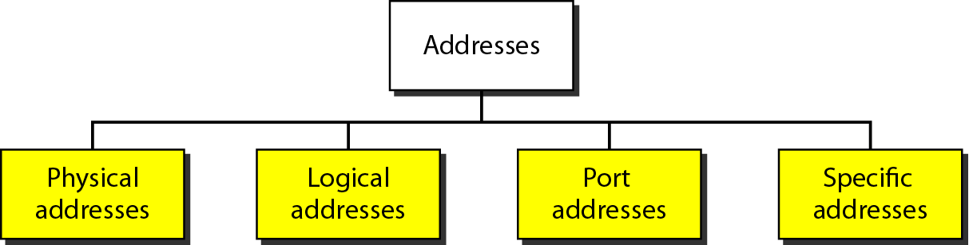
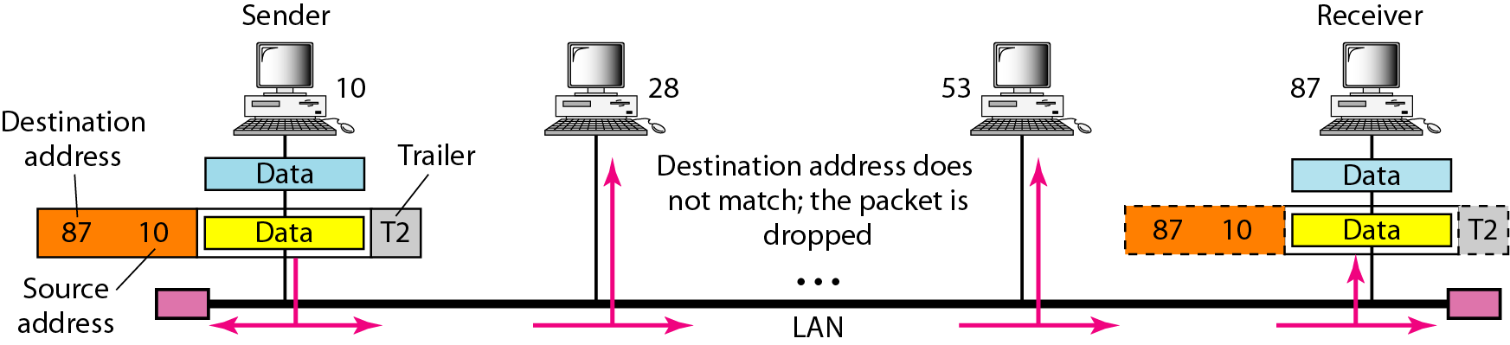
Examples: Physical Address
Four levels of addresses are used in an internet employing the TCP/IP protocols: physical, logical, port, and specific.
In Figure, a node with physical address 10 sends a frame to a node with physical address 87. The two nodes are connected by a link (bus topology LAN). As the figure shows, the computer with physical address 10 is the sender, and the computer with physical address 87 is the receiver.

Slide 6
Physical address
Most local-area networks use a 48-bit (6-byte) physical address written as 12 hexadecimal digits; every byte (2 hexadecimal digits) is separated by a colon, as shown below:
07:01:02:01:2C:4B
A 6-byte (12 hexadecimal digits) physical address.

Slide 7
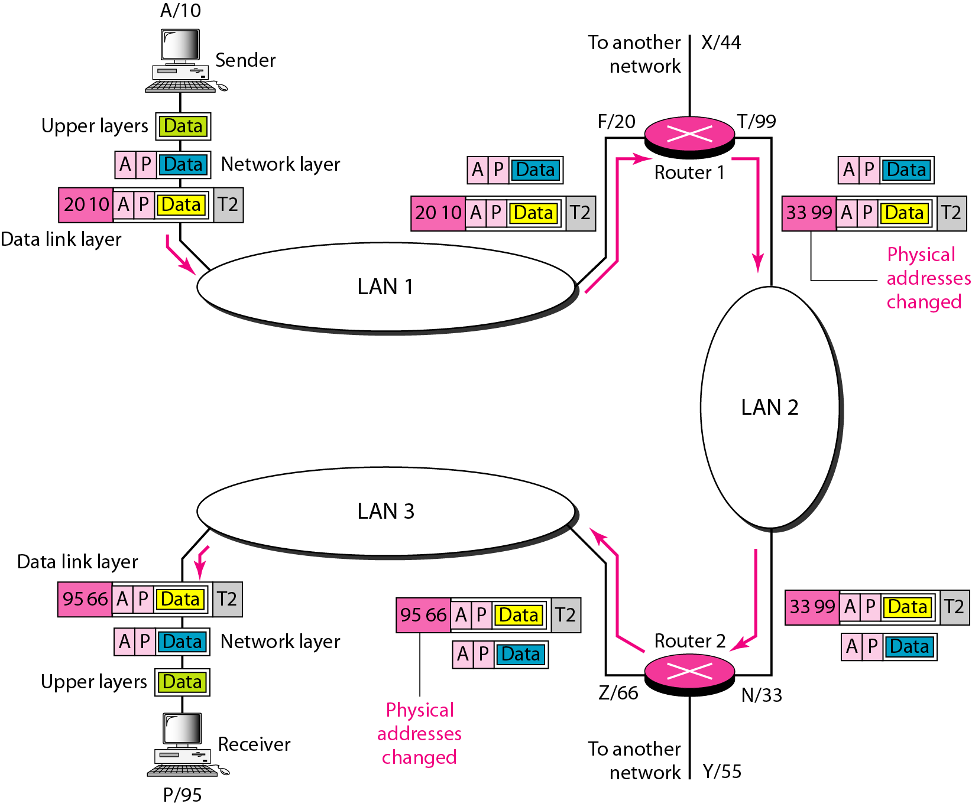
Examples: Physical & Logical addresses
Figure shows a part of an internet with two routers connecting three LANs. Each device (computer or router) has a pair of addresses (logical and physical) for each connection. Each router is connected to three networks (only two are shown in the figure). So each router has three pairs of addresses, one for each connection.

Slide 8
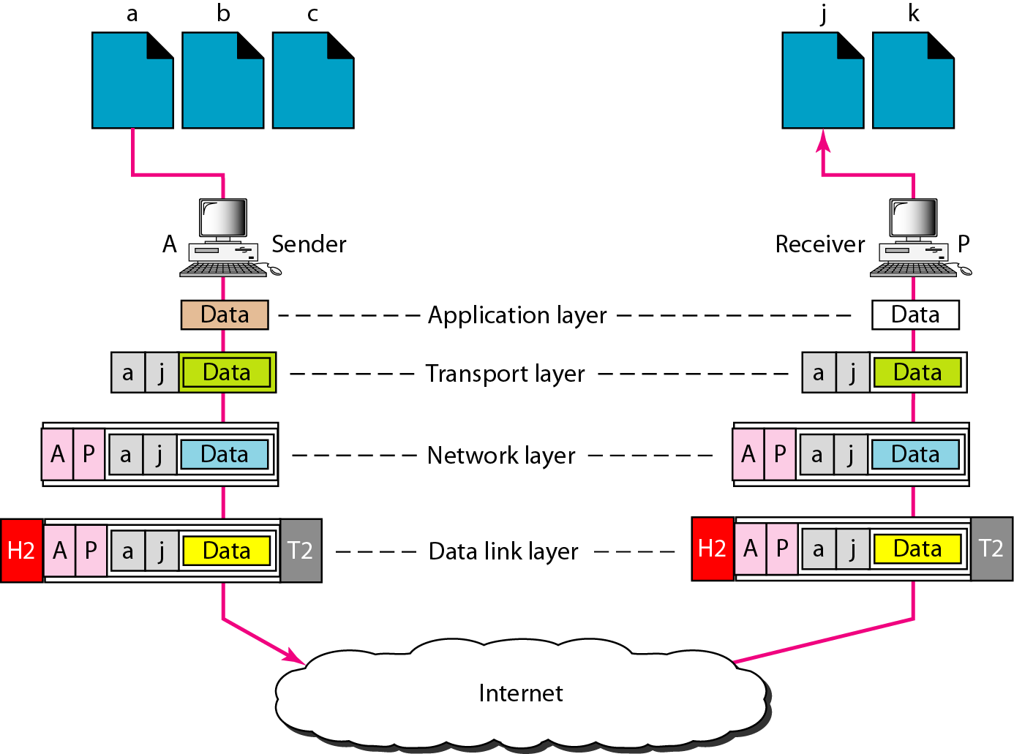
Port addresses

Slide 9
Port addresses
A port address is a 16-bit address represented by one decimal number as shown.
753
A 16-bit port address represented
as one single number.

Slide 10
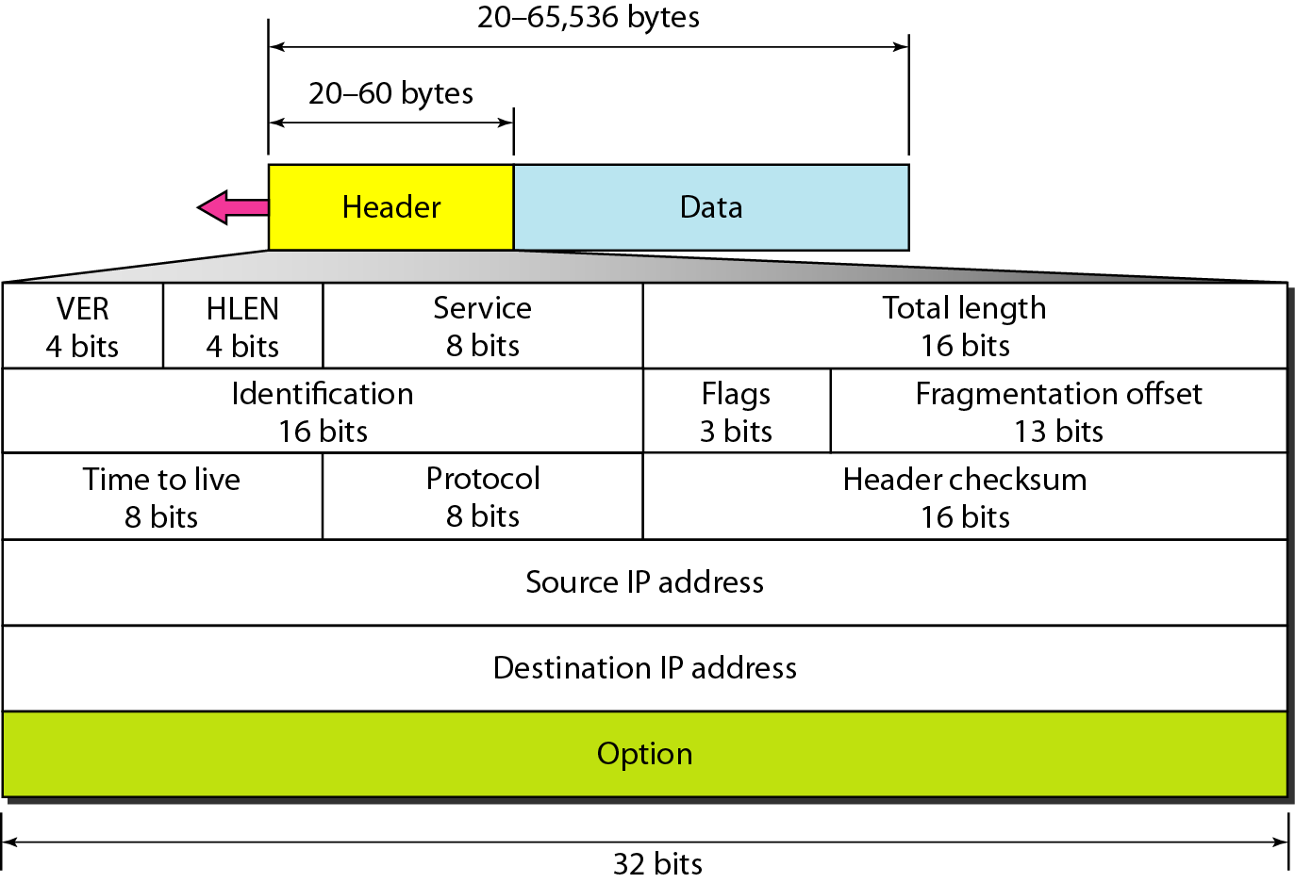
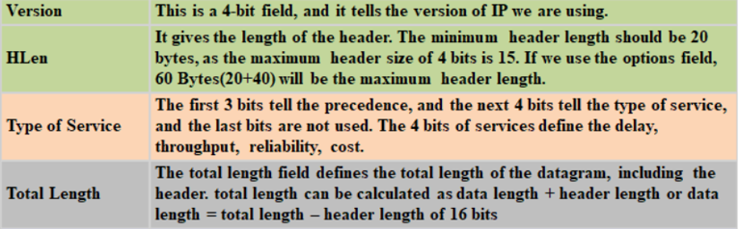
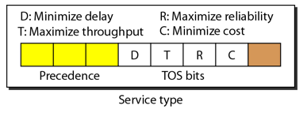
IPv4 Protocol
Table Types of service

Slide 11
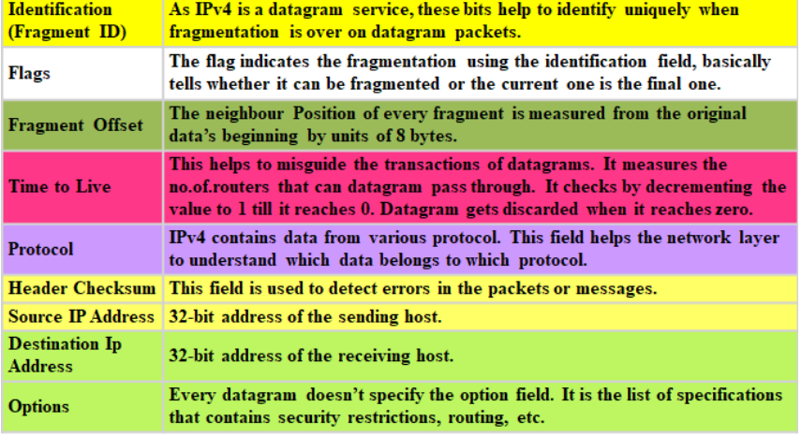
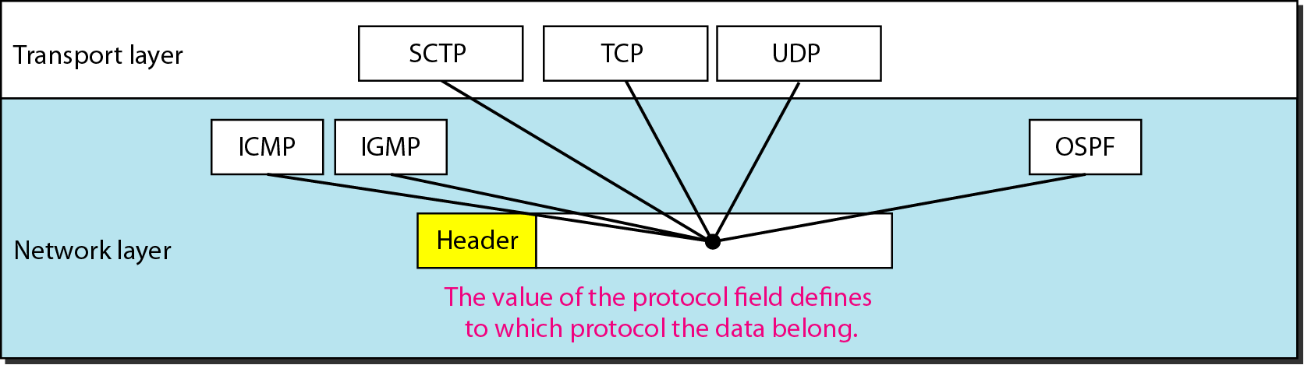

IPv4 Protocol
Protocol field and encapsulated data
Flags used in fragmentation
bit 0: Reserved (always 0)
bit 1 (DF - Don’t Fragment): If 1 → packet cannot be fragmented.
bit 2 (MF - More Fragments): If 1 → more fragments follow; if 0 → last fragment.

Slide 12
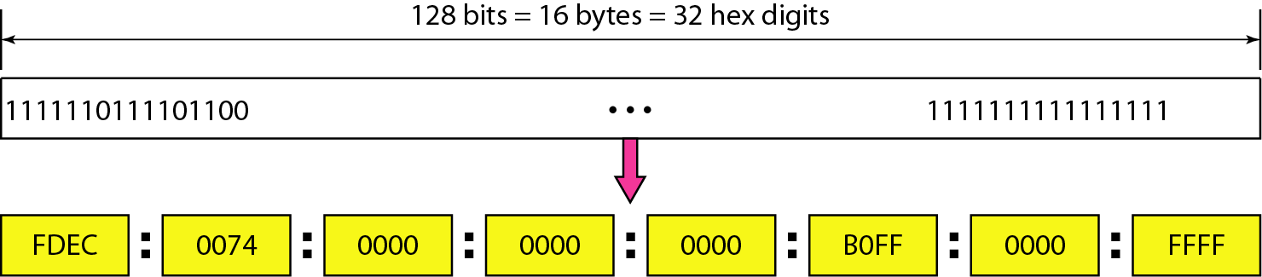
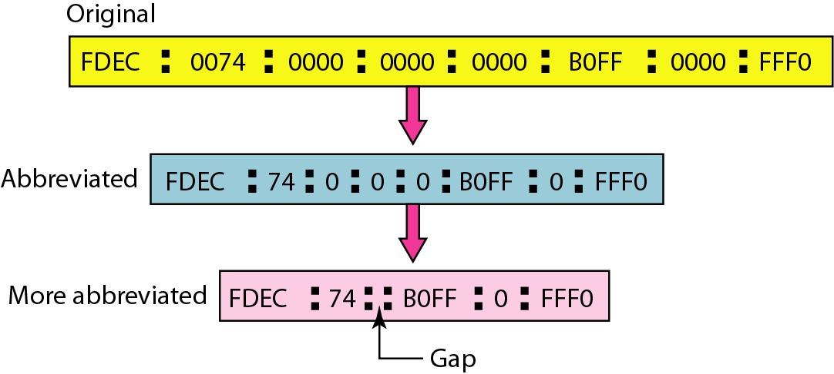
IPv6 Protocol
The Internet Protocol version 6 (IPv6) is the future addressing format.
In recent time it has been noticed that the IPv4 addresses getting exhausted with a rising
number of machines and the public IPs being structured up will go into version 6. An IPv6 address is 128 bits.
Length: 128 bits (compared to 32 bits in IPv4)
Representation: Written as 8 groups of 16 bits each
Each 16-bit is represented as 4 hexadecimal digits
Groups are separated by colons (:)

Slide 13
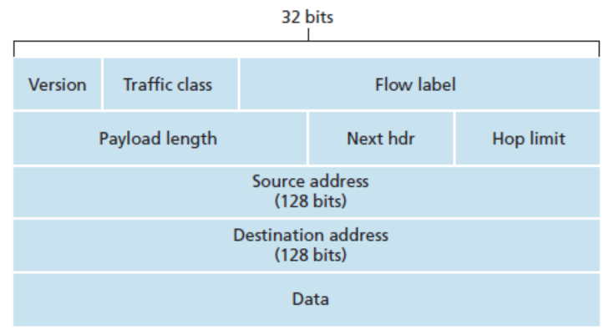
IPv6 Protocol
Version (4-bits)
It shows the version of the internet protocol we used, i.e. 0110
Traffic Class (8-bits)
This is an 8-bit field in which 8 bits are divided into two parts. The most significant 6-bit is for the type of service so that the router will get to know about what services need to be provided to the given packet. And for Explicit Congestion Notification (ECN), the least significant 2-bit is used.
Hop Limit (8-bits)
Hop limit is a field in a header that stops the header from going into an infinite loop in the network.
Source Address (128-bits)
This field provides the address from where the packet originates.
Destination Address (128-bits)
The destination address is the address of the packet's intended recipient.
Flow Label (20-bits)
This 20-bit is required for maintaining the sequential flow of packets related to a particular communication.
Payload Length (16-bits)
This field is used to help the router know how much information is stored in the payload of a particular packet.
Next Header (8-bits)
This field is used to represent the type of extension header

Slide 14
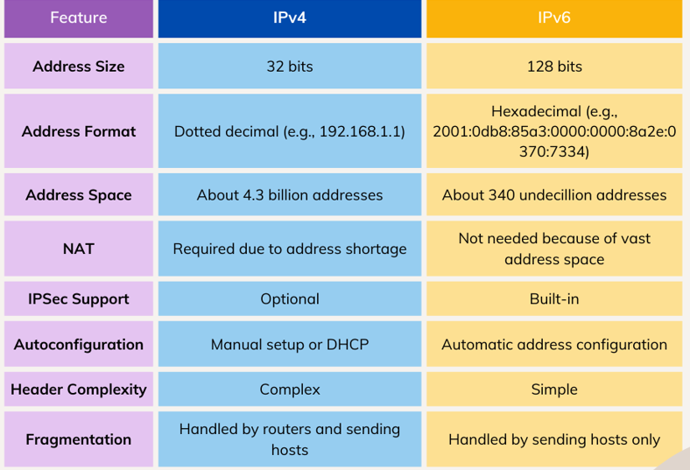
IPv6 vs IPv4 Protocol
Enhanced Security
IPv4 didn’t have any built-in security features. But, IPv6 comes with built in support for IPsec, enhancing privacy, data integrity, and secure authentication across the internet.
Improved Network Efficiency and Performance
Simplified packet headers for more efficient routing and processing.
Eliminates the need for NAT (Network Address Translation), which can complicate communications and reduce performance.

Slide 15
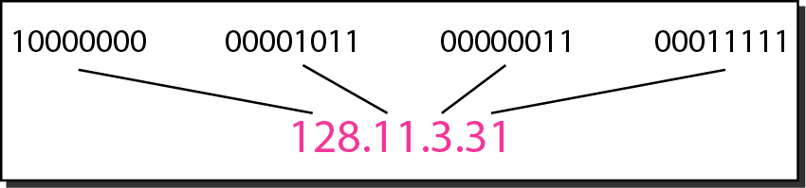
IPv4 Addresses
An IPv4 address is a 32-bit address that uniquely and universally defines the connection of a device
The address space of IPv4 is 2³² or 4,294,967,296.

Slide 16
IPv4 Addresses
Change the following IPv4 addresses from dotted-decimal notation to binary notation.
Solution
We replace each decimal number with its binary equivalent

Slide 17
IPv4 Addresses
Find the error, if any, in the following IPv4 addresses.
Solution
a. There must be no leading zero (045).
b. There can be no more than four numbers.
c. Each number needs to be less than or equal to 255.
d. A mixture of binary notation and dotted-decimal notation is not allowed.

Slide 18
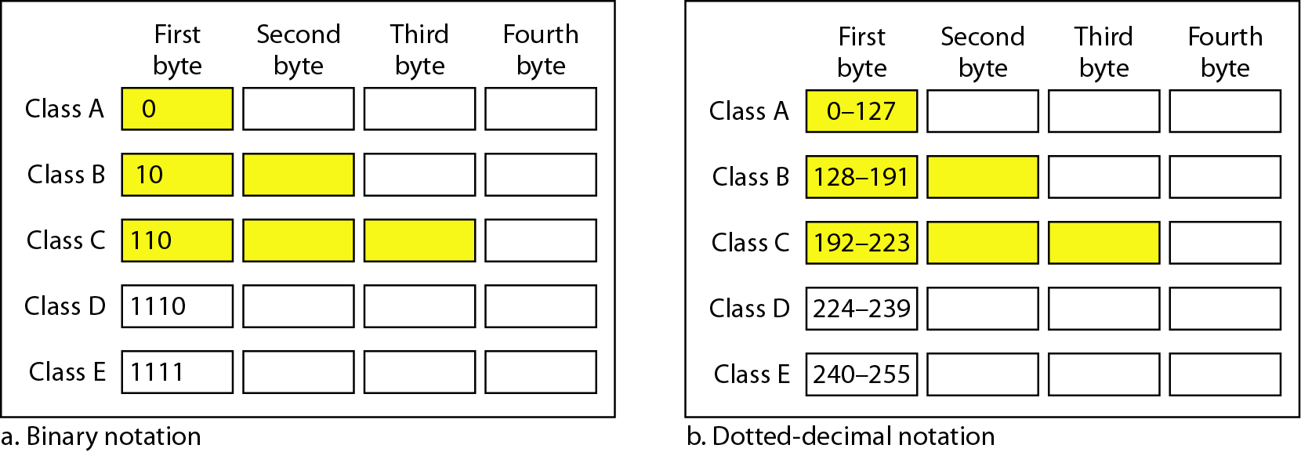
Classful Addressing
In classful addressing, the address space is divided into five classes: A, B, C, D, and E.
An IP address is divided into two parts:
Network ID (Netid): It represents the number of networks.
Host ID (Hostid): It represents the number of hosts.
Netid and Hostid
The netid is in color, the hostid is in white.
Example : In class A, first byte defines the netid and last three bytes define the hostid.

Slide 19
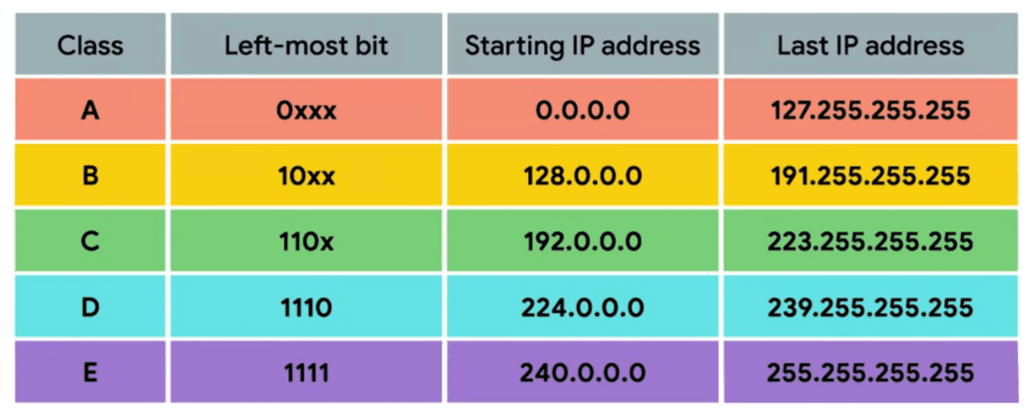
Default Masks for Classful addressing
In an IP address, a mask (also called a subnet mask) is used to separate the network part and the host part of the address.

Slide 20
Classful Addressing
Find the class of each address.
a. 00000001 00001011 00001011 11101111
b. 11000001 10000011 00011011 11111111
c. 14.23.120.8
d. 252.5.15.111
Solution
a. The first bit is 0. This is a class A address.
b. The first 2 bits are 1; the third bit is 0. This is a class C address.
c. The first byte is 14; the class is A.
d. The first byte is 252; the class is E.

Slide 21
Classless Addressing
In classful addressing, a large part of the available addresses were wasted.
Classful addressing, which is almost obsolete, is replaced with classless addressing.
In classless addressing, the network and host portions are not fixed. We use Classless Inter-Domain Routing CIDR notation (/n) to specify how many bits belong to the network.
In IPv4 addressing, a block of addresses can be defined as x.y.z.t /n in which x.y.z.t defines one of the addresses and the /n defines the mask.
Feature | Classful | Classless
Network ID Size | Fixed (based on class) | Flexible (user-defined)
Subnet Mask | Default (e.g., /8, /16, /24) | Custom (e.g., /20, /26)
Routing Protocol | Does not send mask info | Sends mask info
IP Utilization | Inefficient | Efficient
Supports VLSM | ❌ No | ✅ Yes
Example | 192.168.1.0 (Class C) | 192.168.1.0/26

Slide 22
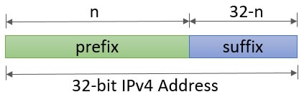
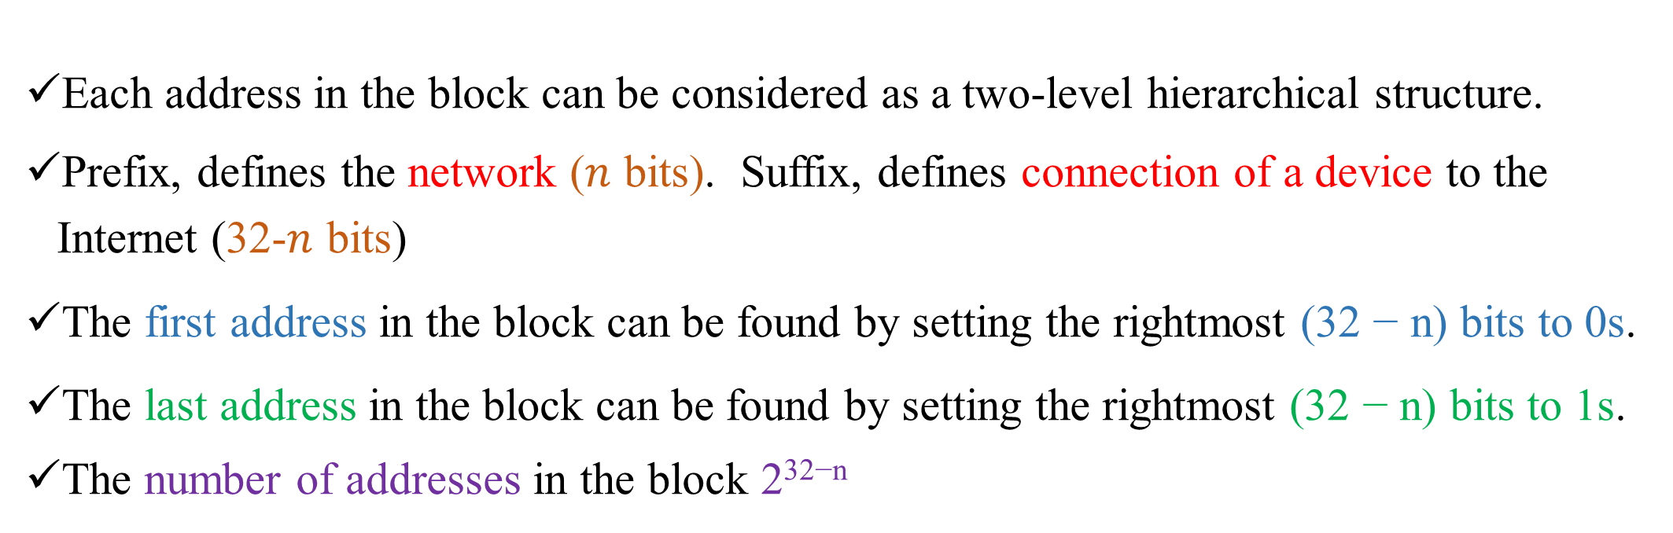
Classless Addressing
Each address in the block can be considered as a two-level hierarchical structure.
Prefix, defines the network ($n$ bits). Suffix, defines connection of a device to the Internet (32-$n$ bits)
The first address in the block can be found by setting the rightmost (32 − n) bits to 0s.
The last address in the block can be found by setting the rightmost (32 − n) bits to 1s.
The number of addresses in the block 2^{32−n}
Network address | The first address in a block of IP addresses
Broadcast address | The last address in a block of IP addresses

Slide 23
Numerical
A block of addresses is granted to a small organization. We know that one of the addresses is 205.16.37.39/28. What is the first address in the block?
Solution
The binary representation of the given address is
11001101 00010000 00100101 0010 0111
If we set 32−28 rightmost bits to 0, we get
11001101 00010000 00100101 0001 0000
or
205.16.37.32.

Slide 24
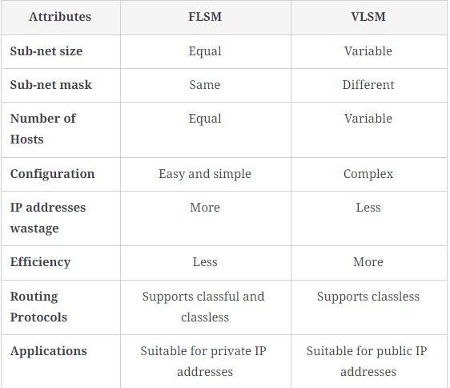
Subnetting
Subnetting is a method of dividing a single physical network into logical sub-networks (subnets).
It improves network efficiency, security, and management.
In FLSM, all subnets have the same subnet mask and therefore equal number of hosts.
In VLSM, subnets can have different subnet masks, allowing for different host counts per subnet. It’s more efficient because it avoids IP wastage.

Slide 25
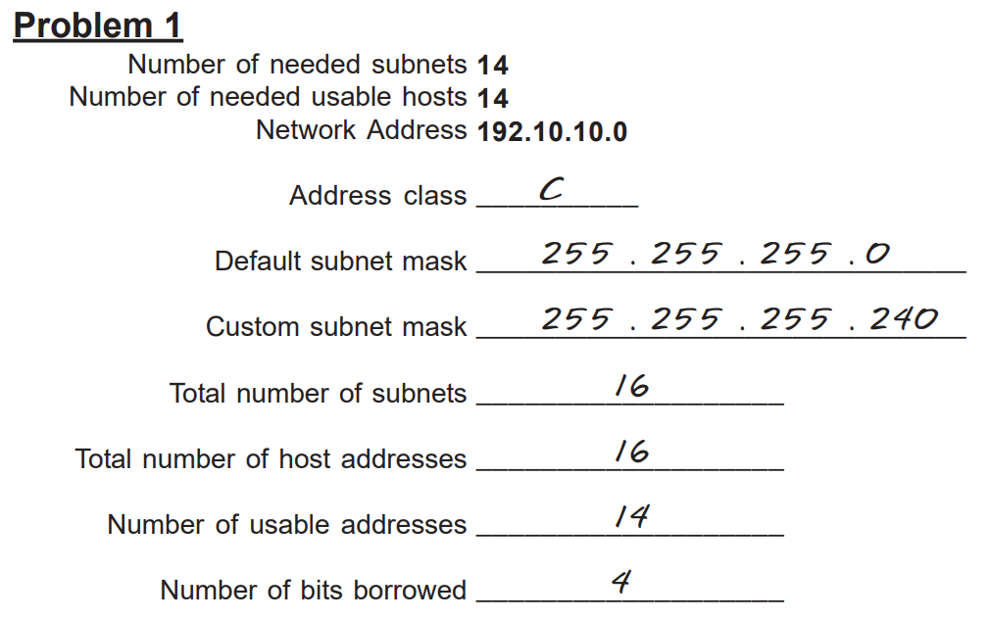
Numerical

Slide 26
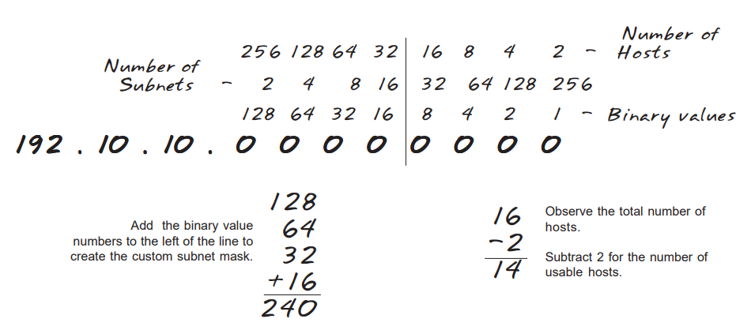

Slide 27
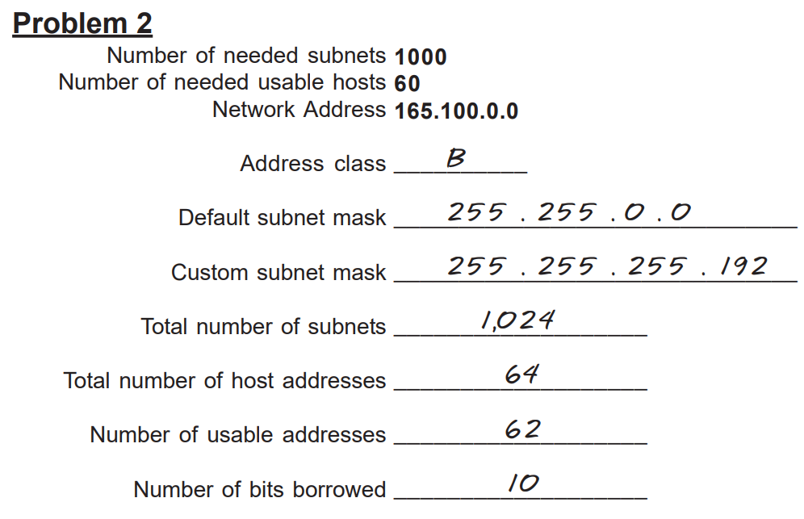
Numerical

Slide 28
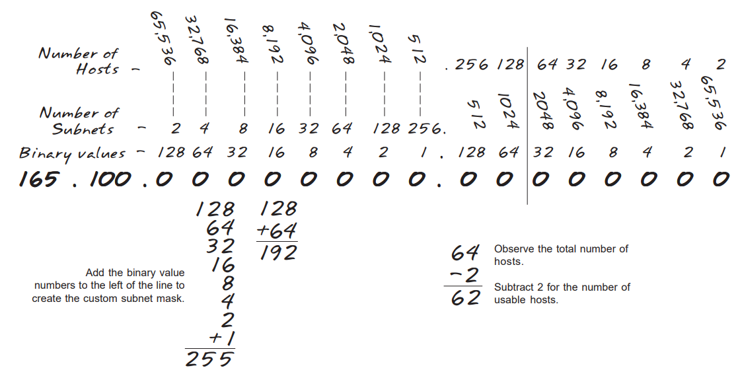

Slide 29
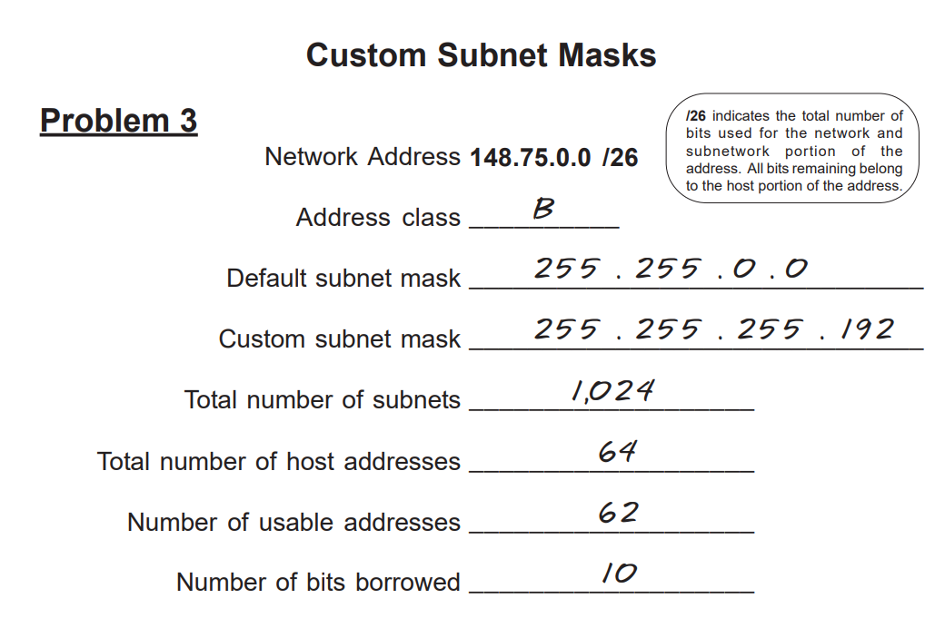
Numerical

Slide 30
Numerical
The given IP addresses is 201.20.30.40/24. Find out the (i) subnet mask, (ii) Network ID, (iii) 4th host ID, (iv) last host ID , (v) broadcast address, (vi) number of subnet, (vii)valid hosts
Number of bits borrowed=24-24=0, Number of Network=2^0=1, Number of hosts=256, Usable =254,
i. Default subnet mask = 255.255.255.0 (/24)
ii. Network ID = 201.20.30.0
iii. 4th host ID = 201.20.30.4
iv. Last host ID (last usable) = 201.20.30.254
v. Broadcast address = 201.20.30.255
vi. Number of subnets = 1 (using default /24, no further subnetting)
vii. Valid hosts per subnet = 254 (2⁸ − 2)

Slide 31
Numerical
The given IP addresses is 183.42.0.0/22. Find out (i) the Class, (ii) default subnet mask, (iii) Custom mask, (iv) number of networks (v) number of hosts per subnet (vi) valid subnets (vii) Broadcast address of each subnet?
Borrowed bits = 22 − 16 = 6 bits
Number of subnets (Networks) = 2⁶ = 64 subnets
Parameter | Value
IP Address | 183.42.0.0/22
Class | B
Default Mask | 255.255.0.0 (/16)
Custom Mask | 255.255.252.0 (/22)
No. of Subnets | 64
Hosts per Subnet | 1022
Valid Subnets | 183.42.0.0, 183.42.4.0, 183.42.8.0, …
Broadcasts | 183.42.3.255, 183.42.7.255, 183.42.11.255, …
Host bits = 32 − 22 = 10 bits
Number of host = 2¹⁰ =1024
Number of usable hosts = 1024− 2
= 1022 hosts / subnet

Slide 32
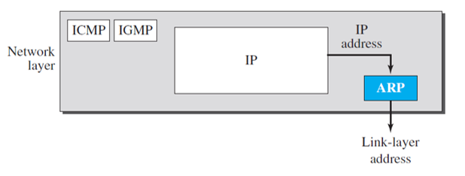
Address Resolution Protocol (ARP)
The delivery of a packet to a host or a router requires two levels of addressing: logical and physical.
We need to be able to map a logical address to its corresponding physical address and vice versa. This can be done by using either static or dynamic mapping.
Address Resolution Protocol (ARP) is the dynamic mapping technique used to map the logical address to a physical address, i.e. ARP accepts the logical address from the IP protocol and maps the address to the corresponding physical address and then passes it to the data link layer.

Slide 33
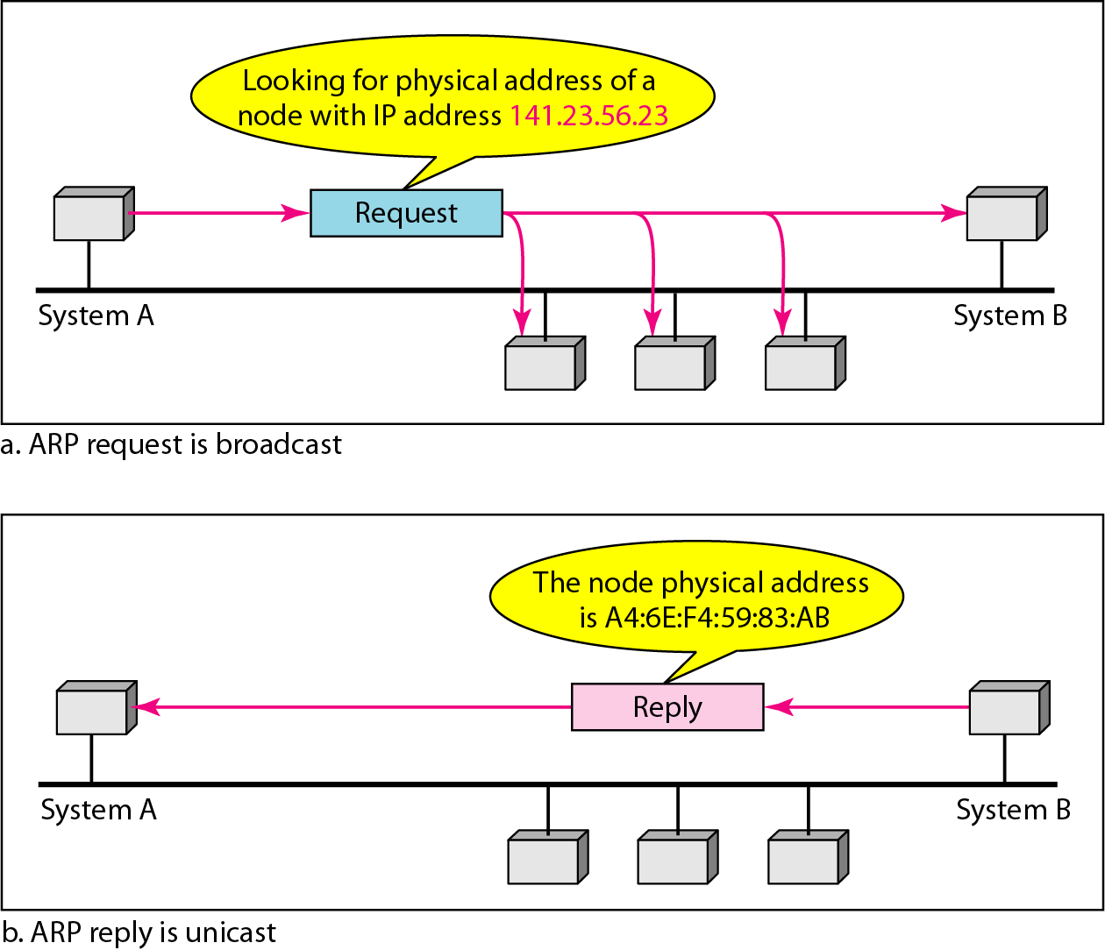
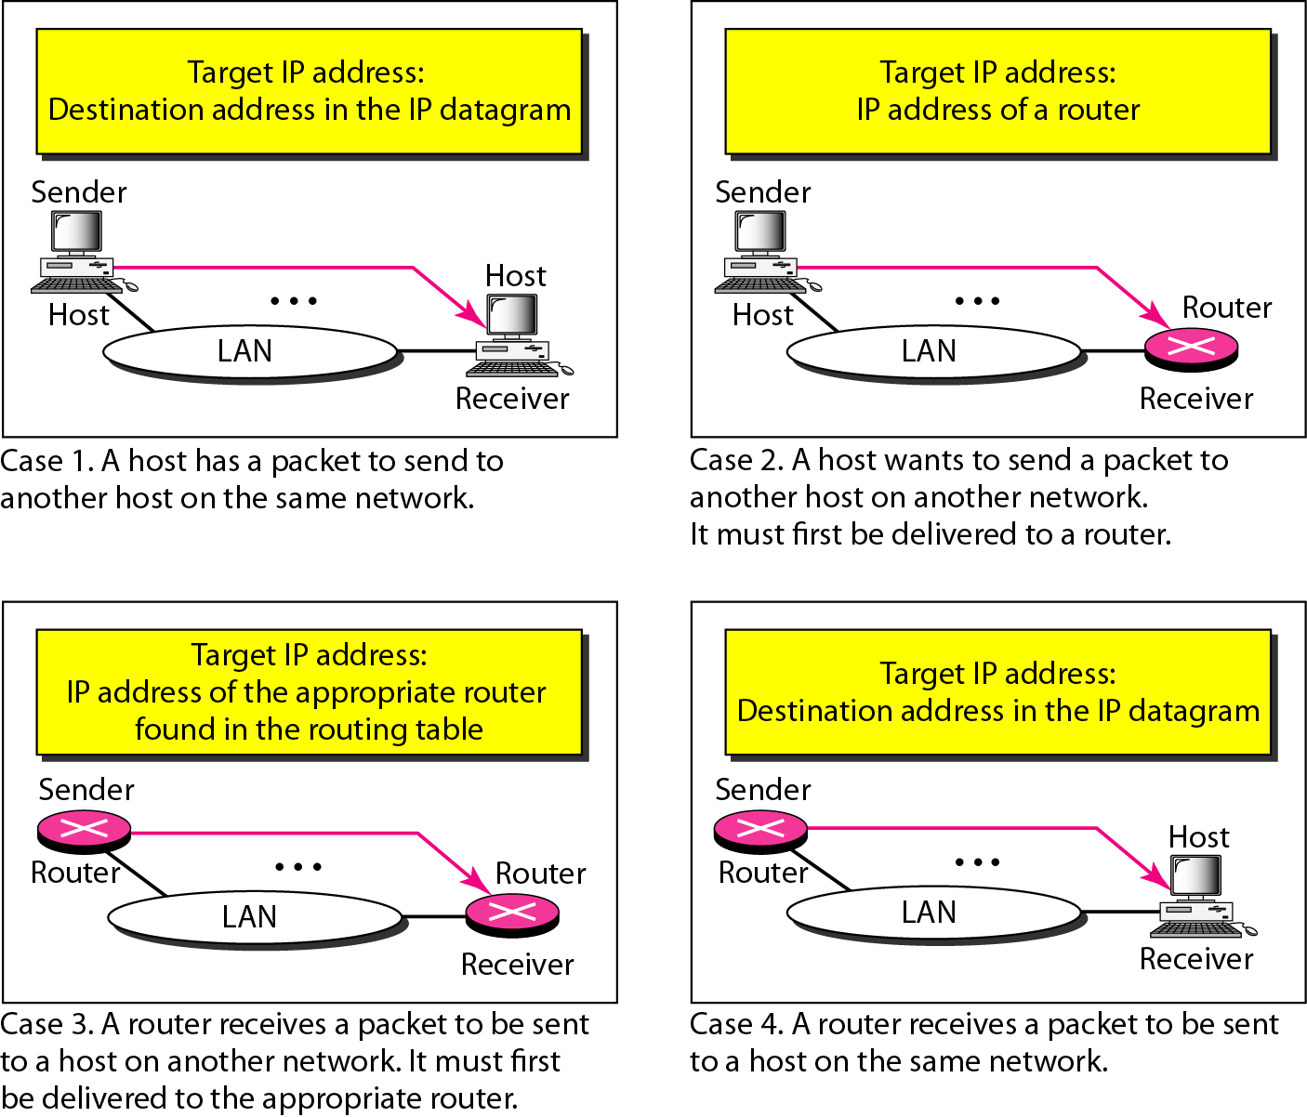
Address Resolution Protocol (ARP)
An ARP request is broadcast;
an ARP reply is unicast.

Slide 34
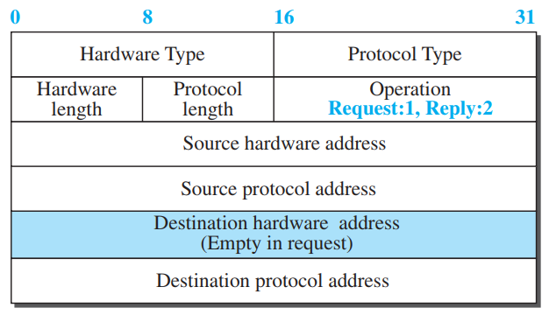

Address Resolution Protocol (ARP)
Hardware type: This is a 16-bit field defining the type of the network on which ARP is running.
Protocol type: This is a 16-bit field defining the protocol. For example, the value of this field for the IPv4 protocol is (0800)16
Hardware length: This is an 8-bit field defining the length of the physical address in bytes. For Ethernet the value is 6.
Protocol length: This is an 8-bit field defining the length of the logical address in bytes. For example, for the IPv4 protocol the value is 4.
Operation: This is a 16-bit field defining the type of packet. Two packet types are defined: ARP request (1) and ARP reply (2).
,

Slide 35
Address Resolution Protocol (ARP)
Sender hardware address: This is a variable-length field defining the physical address of the sender. For example, for Ethernet this field is 6 bytes long.
Sender protocol address: This is a variable-length field defining the logical (for example, IP) address of the sender. For the IP protocol, this field is 4 bytes long.
Destination hardware address: This is a variable-length field defining the physical address of the target. For an ARPrequest message, this field is alI 0s because the sender does not know the physical address of the target.
Destination Protocol address. This is a variable-length field defining the logical (for example, IP) address of the target. For the IPv4 protocol, this field is 4 bytes long.

Slide 36
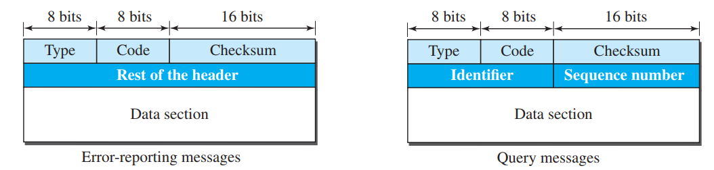
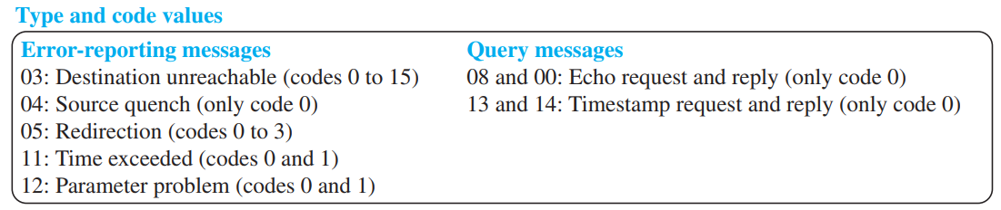
Internet Control Message Protocol ICMP
The IP protocol has no error-reporting or error-correcting mechanism. The IP protocol also lacks a mechanism for host and management queries.
The Internet Control Message Protocol (ICMP) has been designed to compensate for the above two deficiencies.
ICMP messages are divided into two broad categories: error-reporting messages and query messages.

Slide 37
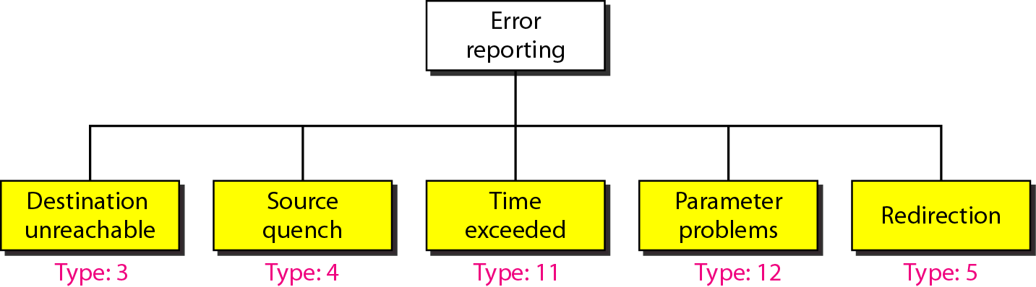
ICMP Error Reporting Messages
The error-reporting messages report problems that a router or a host (destination) may encounter when it processes an IP packet and the message always send to the source host.
Destination Unreachable: The most widely used error message is the destination unreachable (type 3). This message define the type of error message and the reason why a datagram has not reached its final destination.
Source Quench: Source quench (type 4) message informs the sender that the network has encountered congestion and the datagram has been dropped; the source needs to slow down sending more datagrams.
Time Exceeded : When a datagram visits a router, the value of this field is decremented by 1. When the time-to-live value reaches 0, after decrementing, the router discards the datagram.
Redirection Message: The redirection message (type 5) is used when the source uses a wrong router to send out its message.
Parameter Problem: A parameter problem message (type 12) can be sent when there is a problem in the header of a datagram

Slide 38
ICMP Query Messages
Query messages are used to probe or test the liveliness of hosts or routers in the Internet, find the one-way or the round-trip time for an IP datagram between two devices.
Naturally, query messages come in pairs: request and reply. The echo request (type 8) and the echo reply (type 0) pair of messages are used by a host or a router to test the liveliness of another host or router.
A host or router sends an echo request message to another host or router; if the latter is alive, it responds with an echo reply message.
The timestamp request (type 13) and the timestamp reply (type 14) pair of messages are used to find the round-trip time between two devices or to check whether the clocks in two devices are synchronized.

Slide 39
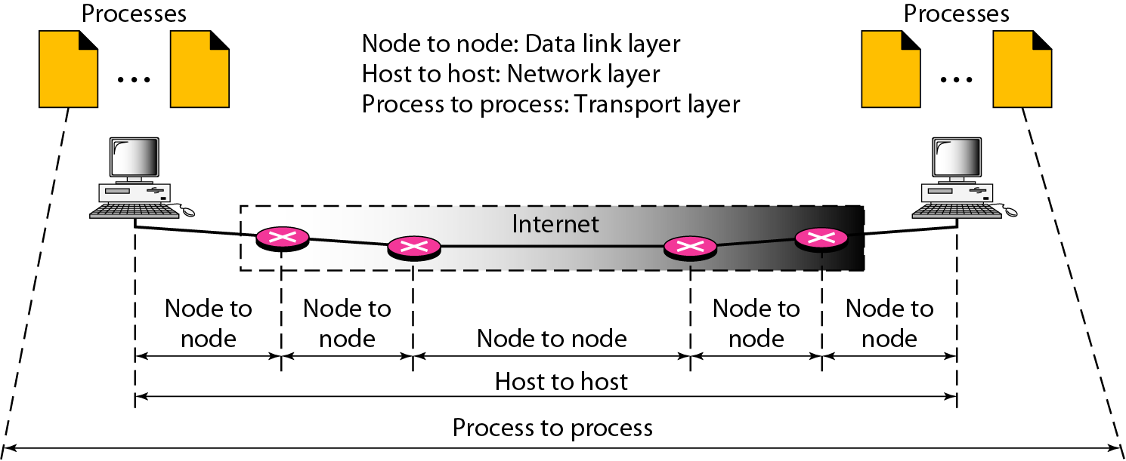
Transport Layer
The transport layer is responsible for process-to-process delivery of a packet.
Two processes communicate in a client/server relationship.

Slide 40
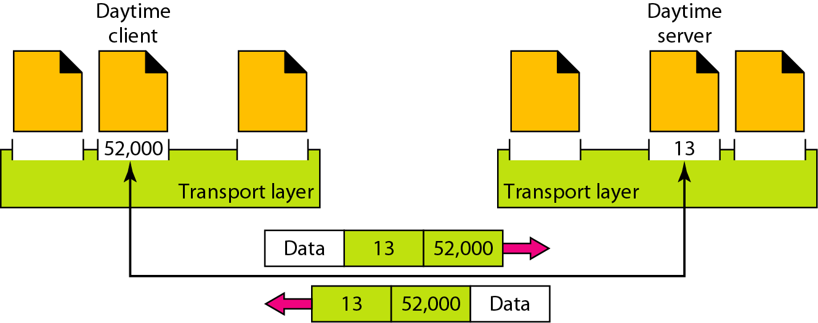
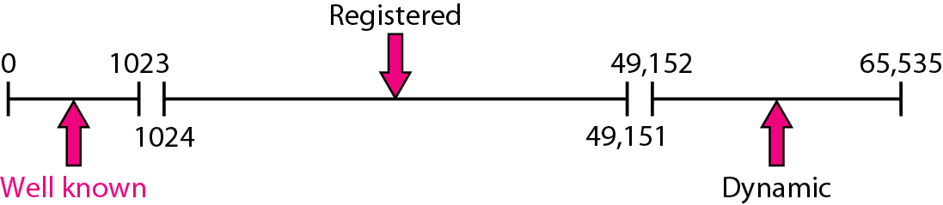
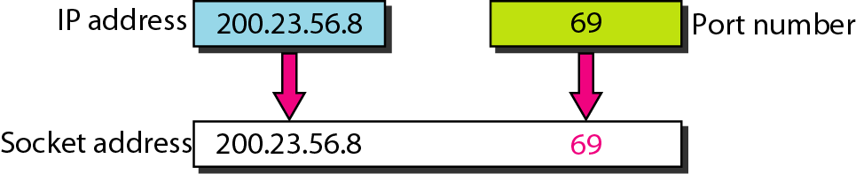
Port Number
The transport layer protocols are port-to-port protocols that work on the top of the IP protocols to deliver the packet.
Each port is defined by a positive integer address, and it is of 16 bits.

Slide 41
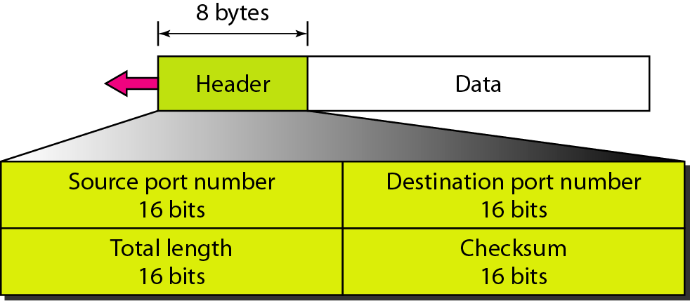
User Datagram Protocol
The transport layer is represented by two protocols: UDP and TCP.
The User Datagram Protocol (UDP) is called a connectionless, unreliable transport protocol. It does not add anything to the services of IP except to provide process-to-process communication.
Source port address: It defines the address of the application process that has delivered a message. The source port address is of 16 bits address.
Destination port address: It defines the address of the application process that will receiver the message. The destination port address is of a 16-bit address.
Total length: It defines the total length of the user datagram in bytes. It is a 16-bit field.
Checksum: The checksum is a 16-bit field which is used in error detection.

Slide 42
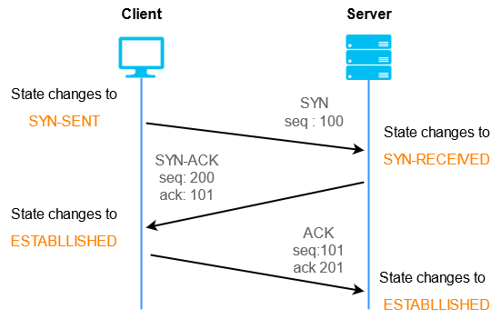
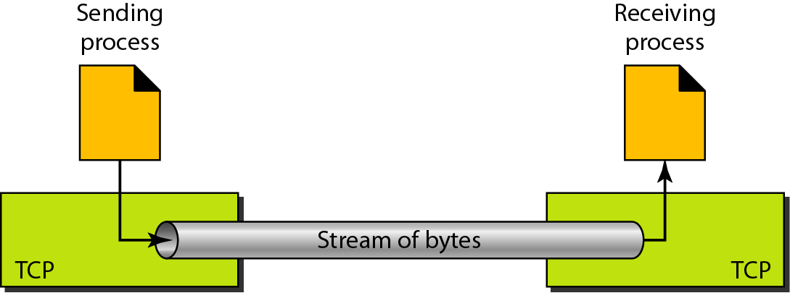
Transmission Control Protocol (TCP)
TCP is a connection-oriented protocol that establishes a logical connection between two TCP endpoints through a 3-way handshake before transmitting data.
In addition, TCP uses flow and error control mechanisms at the transport level.
The bytes of data being transferred in each connection are numbered by TCP. The numbering starts with a randomly generated number.
TCP 3-Way Handshake Process

Slide 43
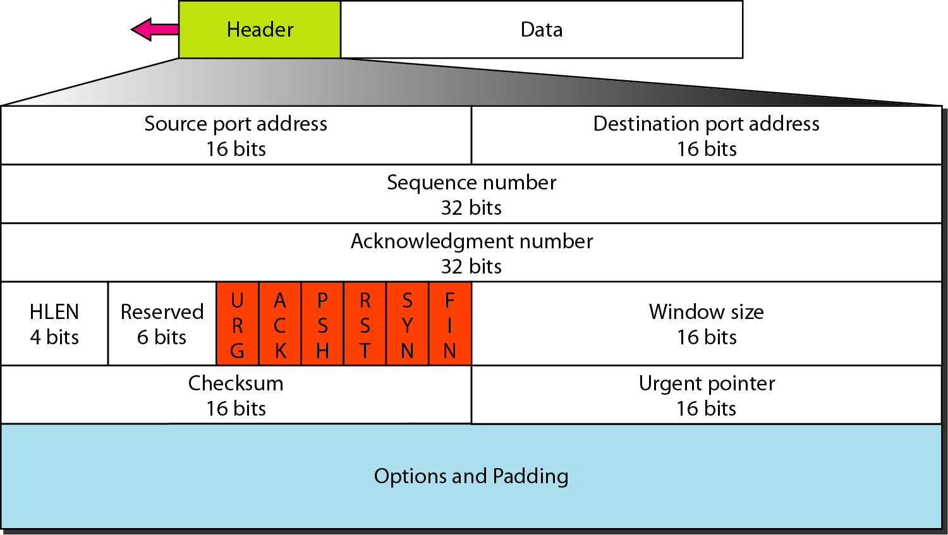
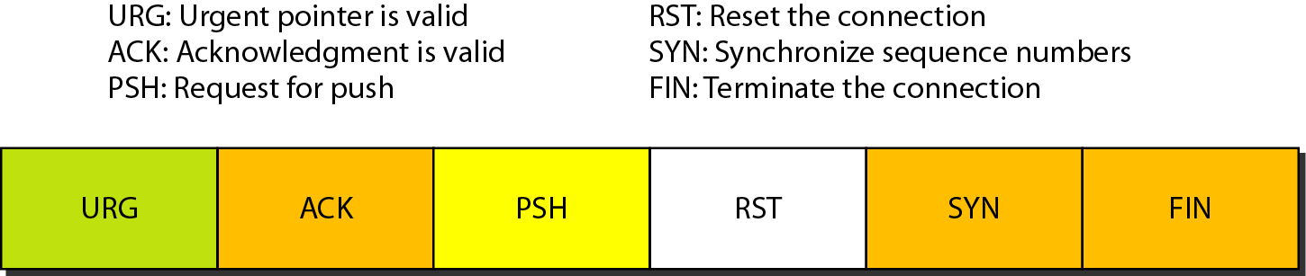
Transmission Control Protocol (TCP)
Field | Purpose
Source Port | Identifies the sending application/process.
Destination Port | Identifies the receiving application/process.
Sequence Number | Identifies the position of data bytes in the TCP stream.
Acknowledgment Number | Indicates the next byte expected from the other side.
Header Length | Specifies the length of the TCP header.
Reserved | Reserved for future use and normally set to 0.
Flags | Control the TCP connection, SYN, ACK, FIN, and RST.
Window Size | Specifies how much data the receiver can accept.
Checksum | Detects errors in the TCP segment.
Urgent Pointer | Indicates the position of urgent data when the URG flag is set.
Options + Padding | Provides additional TCP features and aligns the header.
Data | Contains the actual application data.

Slide 44
Transmission Control Protocol (TCP)
The minimum TCP header size is 20 bytes, and the maximum is 60 bytes.
Source port address: It is used to define the address of the application program in a source computer. It is a 16-bit field.
Destination port address: It is used to define the address of the application program in a destination computer. It is a 16-bit field.
Sequence number: A stream of data is divided into two or more TCP segments. The 32-bit sequence number field represents the position of the data in an original data stream.
Acknowledgement number: A 32-field acknowledgement number acknowledge the data from other communicating devices. If ACK field is set to 1, then it specifies the sequence number that the receiver is expecting to receive

Slide 45
Transmission Control Protocol (TCP)
Header Length (HLEN): It specifies the size of the header which is 4-bit.
Reserved: It is a six-bit field which is reserved for future use.
Control bits: Each bit of a control field functions individually and
independently.
Window Size: The window is a 16-bit field that defines the size of the
window.
Checksum: The checksum is a 16-bit field used in error detection.
Urgent pointer: If URG flag is set to 1, then this 16-bit field is an offset from the sequence number indicating that it is a last urgent data byte.
Options and padding: It defines the optional fields that convey the additional information to the receiver.

Slide 46
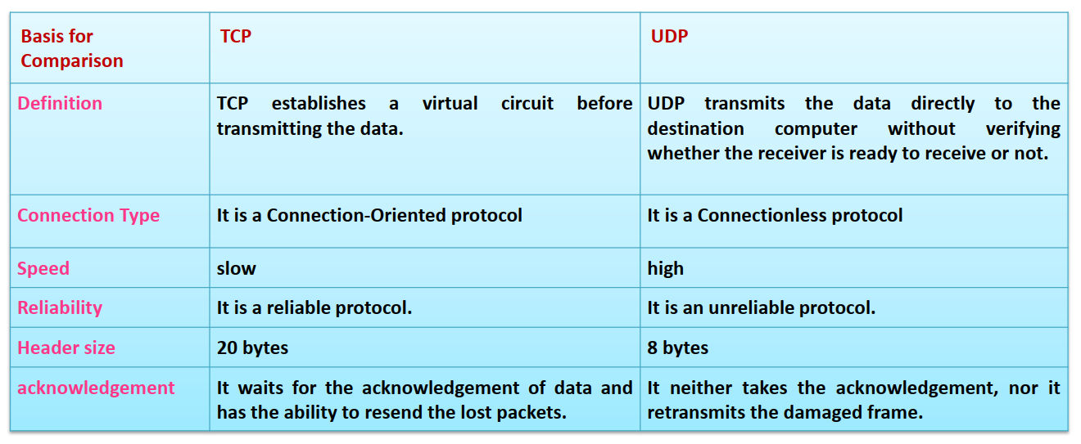
Comparison of TCP Vs DSP

Slide 47
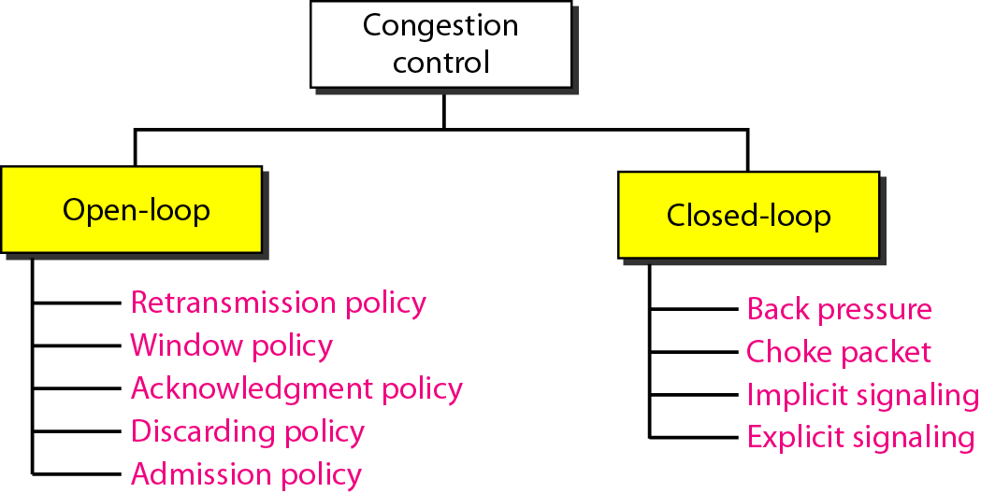
CONGESTION CONTROL
Congestion control refers to techniques and mechanisms that can either prevent congestion, before it happens, or remove congestion, after it has happened.
In general, we can divide congestion control mechanisms into two broad categories: open-loop congestion control (prevention) and closed-loop congestion control (removal).

Slide 48
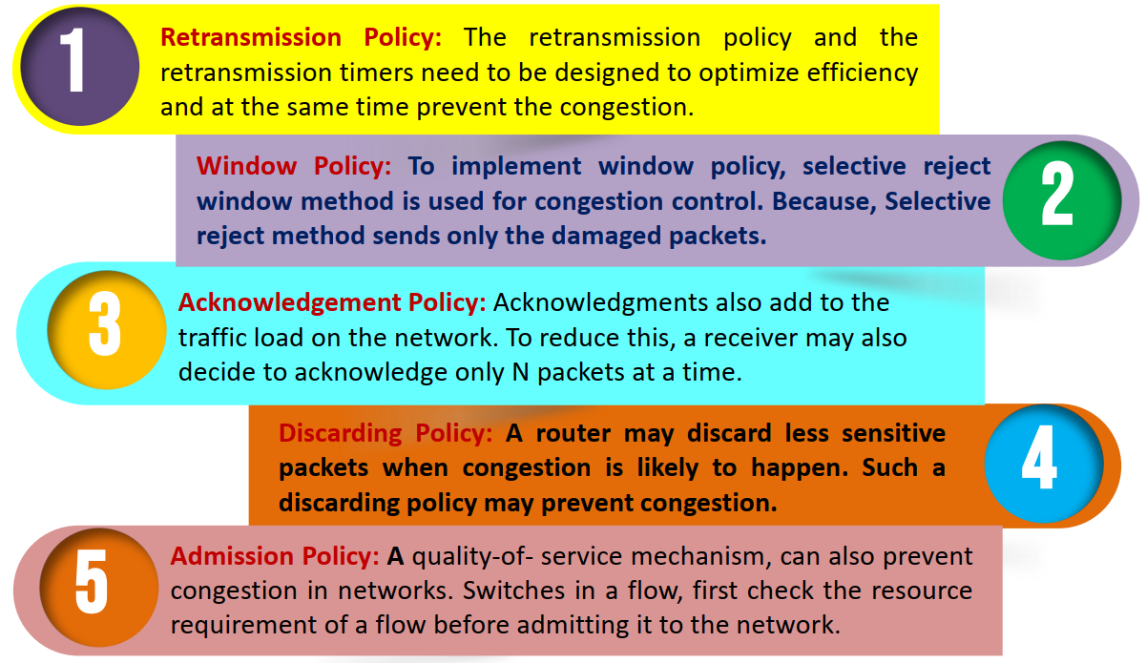
Open loop Congestion Control
In Open Loop
Congestion
Control, policies
are used to
prevent the
congestion before
it happens.

Slide 49
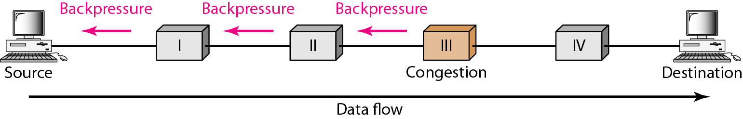
Closed loop Congestion Control
Closed-loop congestion control mechanisms try to alleviate congestion after it happens. Several mechanisms have been used by different protocols.
i. Backpressure : Backpressure is a technique in which a congested node stop receiving packet from upstream node. This may cause the upstream node or nodes to become congested and rejects receiving data from above nodes.
Figure Backpressure method for alleviating congestion

Slide 50
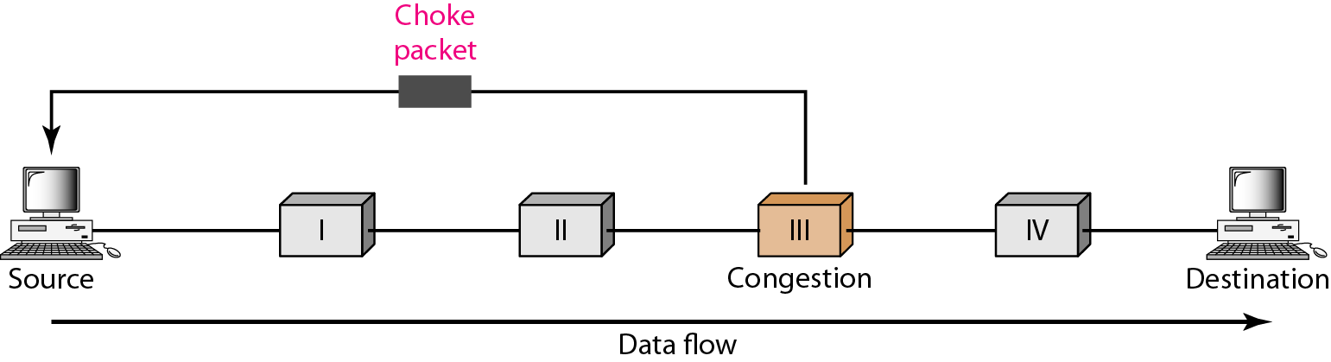
Closed loop Congestion Control
ii. Choke Packet:
A choke packet is a packet sent by a node to the source to inform it of congestion.
Note the difference between the backpressure and choke packet methods. In back pressure, the warning is from one node to its upstream node, although the warning may eventually reach the source station.
In the choke packet method, the warning is from the router, which has encountered congestion, to the source station directly.
The intermediate nodes through which the packet has traveled are not warned.

